Slide 1
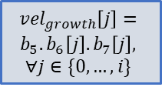


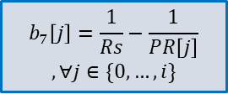
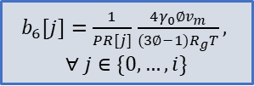






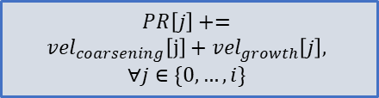



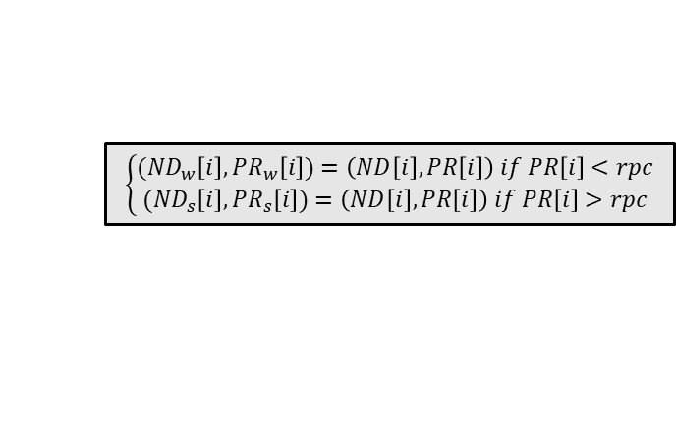

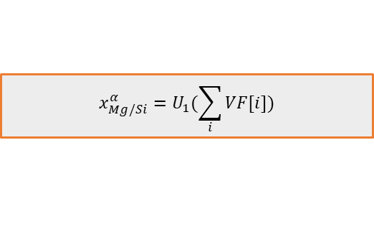

basic
$$σ_{ppt}=S_{1}({τ_{c}}_{weak},{τ_{c}}_{strong})$$
Update block
$${τ_{c}}_{weak}=S_{2}({ND\left[i\right]}_{w},{PR[i]}_{w})$$
$${τ_{c}}_{strong}=S_{3}({ND\left[i\right]}_{w},{PR[i]}_{w})$$
Growth model
Strength model
$$\left\{\begin{aligned}{(ND}_{w}\left[i\right],{PR}_{w}\left[i\right])=\left(ND\left[i\right],PR\left[i\right]\right) if PR\left[i\right]<rpc \\ {(ND}_{s}\left[i\right],{PR}_{s}\left[i\right])=\left(ND\left[i\right],PR\left[i\right]\right) if PR\left[i\right]>rpc\end{aligned}\right.$$
Nucleation model
$$VF\left[j\right]=VF\left(ND\left[j\right], PR\left[j\right]\right)$$
$$∀j∈\{0,…,i\}$$
$$x_{Mg/Si}^{α}=U_{1}(\sum_{i}{VF[i]})$$
$$PR\left[j\right]+=$$
$$vel_{coarsening}\left[j\right]+vel_{growth}\left[j\right],$$
$$∀j∈\{0,…,i\}$$
$$ND\left[i\right]=dt\frac{dN}{dt}, PR\left[i\right]=r_{p}^{∗}$$
$${∆G}^{∗}=N_{1}(γ)$$
$vel_{coarsening}[j]=b_{10}.b_{6}[j].coars/PR[j]$ $,$
$$∀j∈\{0,…,i\}$$
$$\frac{dN}{dt}=N_{5}(Z{,β}^{∗}{,∆G}^{∗})$$
$$r_{p}^{∗}=R_{s}+N_{6}(γ)$$
$$vel_{growth}\left[j\right]=$$
$$b_{5}.b_{6}\left[j\right].b_{7}\left[j\right],$$
$$∀j∈\{0,…,i\}$$
$b_{6}[j]=\frac{1}{PR[j]}$ $\frac{4γ_{0}∅v_{m}}{(3∅−1)R_{g}T},$
$$∀ j∈\{0,…,i\}$$
$$β^{∗}=N_{4}(R_{s},x_{Mg/Si}^{α})$$
$$Z=N_{2}(γ;R_{s})$$
$$b_{5}=G_{1}(x_{Mg/Si}^{α})$$
$$b_{7}\left[j\right]=\frac{1}{Rs}−\frac{1}{PR\left[j\right]}$$
$$,∀j∈\{0,…,i\}$$
$$R_{s}=N_{3}(γ)$$

Slide 2
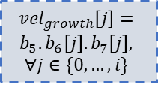


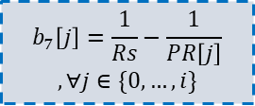
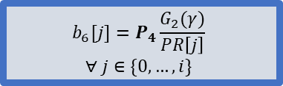
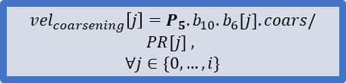





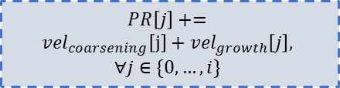





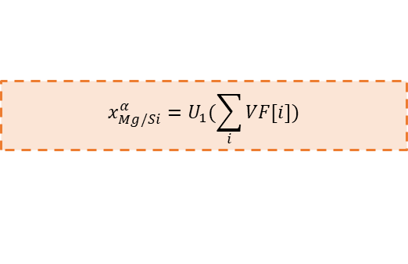

Dashed and solid outlines
$$σ_{ppt}=S_{1}({τ_{c}}_{weak},{τ_{c}}_{strong})$$
Update block
$${τ_{c}}_{weak}=S_{2}({ND\left[i\right]}_{w},{PR[i]}_{w})$$
$${τ_{c}}_{strong}=S_{3}({ND\left[i\right]}_{w},{PR[i]}_{w})$$
Growth model
Strength model
$$\left\{\begin{aligned}{(ND}_{w}\left[i\right],{PR}_{w}\left[i\right])=\left(ND\left[i\right],PR\left[i\right]\right) if PR\left[i\right]<rpc \\ {(ND}_{s}\left[i\right],{PR}_{s}\left[i\right])=\left(ND\left[i\right],PR\left[i\right]\right) if PR\left[i\right]>rpc\end{aligned}\right.$$
Nucleation model
$$VF[i]=VF(ND\left[i\right], PR[i])$$
$$x_{Mg/Si}^{α}=U_{1}(\sum_{i}{VF[i]})$$
$$PR\left[j\right]+=$$
$$vel_{coarsening}\left[j\right]+vel_{growth}\left[j\right],$$
$$∀j∈\{0,…,i\}$$
$$ND\left[i\right]=dt\frac{dN}{dt}, PR\left[i\right]=r_{p}^{∗}$$
$${∆G}^{∗}={P_{2}.N}_{1}(γ)$$
$vel_{coarsening}\left[j\right]=P_{5}.b_{10}.b_{6}[j].coars/PR[j]$ $,$
$$∀j∈\{0,…,i\}$$
$$\frac{dN}{dt}=N_{5}(Z{,β}^{∗}{,∆G}^{∗})$$
$$r_{p}^{∗}=R_{s}+P_{3.}N_{6}(γ)$$
$$vel_{growth}\left[j\right]=$$
$$b_{5}.b_{6}\left[j\right].b_{7}\left[j\right],$$
$$∀j∈\{0,…,i\}$$
$$β^{∗}=N_{4}(R_{s},x_{Mg/Si}^{α})$$
$$b_{6}[j]=P_{4}\frac{G_{2}(γ)}{PR\left[j\right]}$$
$$∀ j∈\{0,…,i\}$$
$$Z=N_{2}(γ;R_{s})$$
$$b_{5}=G_{1}(x_{Mg/Si}^{α})$$
$$b_{7}\left[j\right]=\frac{1}{Rs}−\frac{1}{PR\left[j\right]}$$
$$,∀j∈\{0,…,i\}$$
$$R_{s}=P_{1}.N_{3}(γ)$$

Slide 3
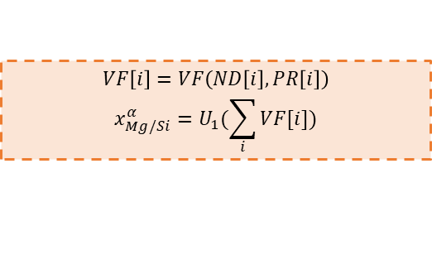














Consistent colors of the arrows
$$σ_{ppt}=S_{1}({τ_{c}}_{weak},{τ_{c}}_{strong})$$
Update block
$${τ_{c}}_{weak}=S_{2}({ND\left[i\right]}_{w},{PR[i]}_{w})$$
$${τ_{c}}_{strong}=S_{3}({ND\left[i\right]}_{w},{PR[i]}_{w})$$
Growth model
Strength model
$$\left\{\begin{aligned}{(ND}_{w}\left[i\right],{PR}_{w}\left[i\right])=\left(ND\left[i\right],PR\left[i\right]\right) if PR\left[i\right]<rpc \\ {(ND}_{s}\left[i\right],{PR}_{s}\left[i\right])=\left(ND\left[i\right],PR\left[i\right]\right) if PR\left[i\right]>rpc\end{aligned}\right.$$
Nucleation model
$$VF\left[i\right]=VF\left(ND\left[i\right], PR\left[i\right]\right)$$
$$x_{Mg/Si}^{α}=U_{1}(\sum_{i}{VF[i]})$$
$$PR\left[j\right]+=$$
$$vel_{coarsening}\left[j\right]+vel_{growth}\left[j\right],$$
$$∀j∈\{0,…,i\}$$
$$ND\left[i\right]=dt\frac{dN}{dt}, PR\left[i\right]=r_{p}^{∗}$$
$${∆G}^{∗}={P_{2}.N}_{1}(γ)$$
$vel_{coarsening}\left[j\right]=P_{5}.b_{10}.b_{6}[j].coars/PR[j]$ $,$
$$∀j∈\{0,…,i\}$$
$$\frac{dN}{dt}=N_{5}(Z{,β}^{∗}{,∆G}^{∗})$$
$$r_{p}^{∗}=R_{s}+P_{3.}N_{6}(γ)$$
$$vel_{growth}\left[j\right]=$$
$$b_{5}.b_{6}\left[j\right].b_{7}\left[j\right],$$
$$∀j∈\{0,…,i\}$$
$$β^{∗}=N_{4}(R_{s},x_{Mg/Si}^{α})$$
$$b_{6}[j]=P_{4}\frac{G_{2}(γ)}{PR\left[j\right]}$$
$$∀ j∈\{0,…,i\}$$
$$Z=N_{2}(γ;R_{s})$$
$$b_{5}=G_{1}(x_{Mg/Si}^{α})$$
$$b_{7}\left[j\right]=\frac{1}{Rs}−\frac{1}{PR\left[j\right]}$$
$$,∀j∈\{0,…,i\}$$
$$R_{s}=P_{1}.N_{3}(γ)$$

Slide 4








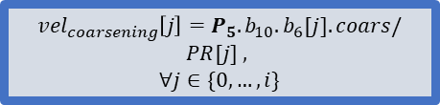


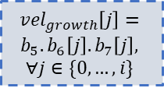




Top to bottom
$$R_{s}=P_{1}.N_{3}(γ)$$
$$b_{5}=G_{1}(x_{Mg/Si}^{α})$$
$$Z=N_{2}(γ;R_{s})$$
$$b_{7}\left[j\right]=\frac{1}{Rs}−\frac{1}{PR\left[j\right]}$$
$$,∀j∈\{0,…,i\}$$
$vel_{coarsening}\left[j\right]=P_{5}.b_{10}.b_{6}[j].coars/PR[j]$ $,$
$$∀j∈\{0,…,i\}$$
$$β^{∗}=N_{4}(R_{s},x_{Mg/Si}^{α})$$
$$r_{p}^{∗}=R_{s}+P_{3.}N_{6}(γ)$$
$$vel_{growth}\left[j\right]=$$
$$b_{5}.b_{6}\left[j\right].b_{7}\left[j\right],$$
$$∀j∈\{0,…,i\}$$
$$\frac{dN}{dt}=N_{5}(Z{,β}^{∗}{,∆G}^{∗})$$
$$b_{6}[j]=P_{4}\frac{G_{2}(γ)}{PR\left[j\right]}$$
$$∀ j∈\{0,…,i\}$$
$$ND\left[i\right]=dt\frac{dN}{dt}, PR\left[i\right]=r_{p}^{∗}$$
$${∆G}^{∗}={P_{2}.N}_{1}(γ)$$
$$VF\left[i\right]=VF\left(ND\left[i\right], PR\left[i\right]\right)$$
$$x_{Mg/Si}^{α}=U_{1}(\sum_{i}{VF[i]})$$
$$PR\left[j\right]+=$$
$$vel_{coarsening}\left[j\right]+vel_{growth}\left[j\right],$$
$$∀j∈\{0,…,i\}$$
$$\left\{\begin{aligned}{(ND}_{w}\left[i\right],{PR}_{w}\left[i\right])=\left(ND\left[i\right],PR\left[i\right]\right) if PR\left[i\right]<rpc \\ {(ND}_{s}\left[i\right],{PR}_{s}\left[i\right])=\left(ND\left[i\right],PR\left[i\right]\right) if PR\left[i\right]>rpc\end{aligned}\right.$$
$${τ_{c}}_{weak}=S_{2}({ND\left[i\right]}_{w},{PR[i]}_{w})$$
$${τ_{c}}_{strong}=S_{3}({ND\left[i\right]}_{w},{PR[i]}_{w})$$
$$σ_{ppt}=S_{1}({τ_{c}}_{weak},{τ_{c}}_{strong})$$

Slide 5


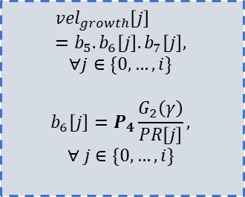


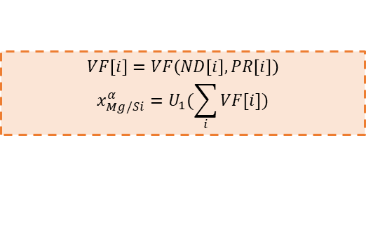
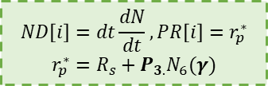

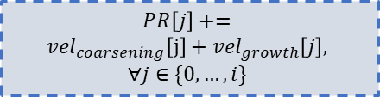


compact
$$R_{s}=P_{2}.N_{3}(γ)$$
$$b_{5}=G_{1}(x_{Mg/Si}^{α})$$
$$vel_{growth}\left[j\right]=b_{5}.b_{6}\left[j\right].b_{7}\left[j\right],$$
$$∀j∈\{0,…,i\}$$
$$b_{6}\left[j\right]=P_{4}\frac{G_{2}\left(γ\right)}{PR\left[j\right]},$$
$$∀ j∈\{0,…,i\}$$
$$β^{∗}=N_{4}(R_{s},x_{Mg/Si}^{α})$$
$$\frac{dN}{dt}=N_{5}(Z{,β}^{∗}{,∆G}^{∗})$$
$$Z={P_{1}.N}_{2}(γ;R_{s})$$
$${∆G}^{∗}=N_{1}(γ)$$
$$b_{7}\left[j\right]=\frac{1}{Rs}−\frac{1}{PR\left[j\right]}$$
$$,∀j∈\{0,…,i\}$$
$$ND\left[i\right]=dt\frac{dN}{dt}, PR\left[i\right]=r_{p}^{∗}$$
$$r_{p}^{∗}=R_{s}+P_{3.}N_{6}(γ)$$
$vel_{coarsening}\left[j\right]=P_{5}.b_{10}.b_{6}[j].coars/PR[j]$ $,$
$$∀j∈\{0,…,i\}$$
$$VF\left[i\right]=VF\left(ND\left[i\right], PR\left[i\right]\right)$$
$$x_{Mg/Si}^{α}=U_{1}(\sum_{i}{VF[i]})$$
$$PR\left[j\right]+=$$
$$vel_{coarsening}\left[j\right]+vel_{growth}\left[j\right],$$
$$∀j∈\{0,…,i\}$$
$$\left\{\begin{aligned}{(ND}_{w}\left[i\right],{PR}_{w}\left[i\right])=\left(ND\left[i\right],PR\left[i\right]\right) if PR\left[i\right]<rpc \\ {(ND}_{s}\left[i\right],{PR}_{s}\left[i\right])=\left(ND\left[i\right],PR\left[i\right]\right) if PR\left[i\right]>rpc\end{aligned}\right.$$
Nucleation model
Growth model
$${τ_{c}}_{weak}=S_{2}({ND\left[i\right]}_{w},{PR[i]}_{w})$$
$${τ_{c}}_{strong}=S_{3}({ND\left[i\right]}_{w},{PR[i]}_{w})$$
$$σ_{ppt}=S_{1}({τ_{c}}_{weak},{τ_{c}}_{strong})$$
Strength model
Update block

Slide 6
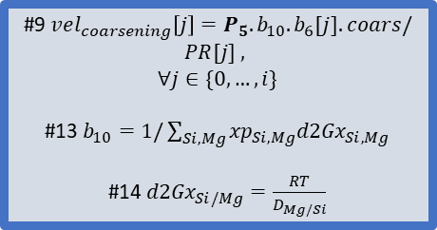


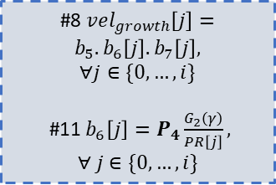



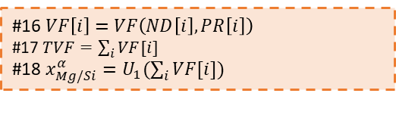


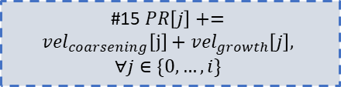
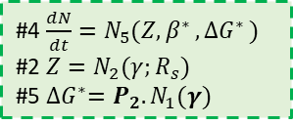


Eq#
#1 $R_{s}=P_{1}.N_{3}\left(γ\right)$
#10 $b_{5}=G_{1}(x_{Mg/Si}^{α})$
#8 $vel_{growth}\left[j\right]=b_{5}.b_{6}\left[j\right].b_{7}\left[j\right],$
$$∀j∈\{0,…,i\}$$
#11 $b_{6}\left[j\right]=P_{4}\frac{G_{2}\left(γ\right)}{PR\left[j\right]},$
$$∀ j∈\{0,…,i\}$$
#3 $β^{∗}=N_{4}(R_{s},x_{Mg/Si}^{α})$
#12 $b_{7}\left[j\right]=\frac{1}{Rs}−\frac{1}{PR\left[j\right]}$
$$,∀j∈\{0,…,i\}$$
#4 $\frac{dN}{dt}=N_{5}(Z{,β}^{∗}{,∆G}^{∗})$
#2 $Z=N_{2}(γ;R_{s})$
#5 ${∆G}^{∗}=P_{2}.N_{1}(γ)$
#6 $ND\left[i\right]=dt\frac{dN}{dt}$
#7 $PR\left[i\right]=R_{s}+P_{3.}N_{6}(γ)$
#9 $vel_{coarsening}\left[j\right]=P_{5}.b_{10}.b_{6}[j].coars/PR[j]$ $,$
$$∀j∈\{0,…,i\}$$
#13 $b_{10}=1/\sum_{Si, Mg}{{xp}_{Si,Mg}{d2Gx}_{Si,Mg}}$
#14 ${d2Gx}_{Si/Mg}=\frac{RT}{D_{Mg/Si}}$
#16 $VF\left[i\right]=VF\left(ND\left[i\right], PR\left[i\right]\right)$
#17 $TVF=\sum_{i}{VF[i]}$
#18 $x_{Mg/Si}^{α}=U_{1}(\sum_{i}{VF[i]})$
#15 $PR\left[j\right]+=$
$$vel_{coarsening}\left[j\right]+vel_{growth}\left[j\right],$$
$$∀j∈\{0,…,i\}$$
$$\left\{\begin{aligned}{(ND}_{w}\left[i\right],{PR}_{w}\left[i\right])=\left(ND\left[i\right],PR\left[i\right]\right) if PR\left[i\right]<rpc \\ {(ND}_{s}\left[i\right],{PR}_{s}\left[i\right])=\left(ND\left[i\right],PR\left[i\right]\right) if PR\left[i\right]>rpc\end{aligned}\right.$$
#19 ${τ_{c}}_{weak}=S_{2}({ND\left[i\right]}_{w},{PR[i]}_{w})$
#20 ${τ_{c}}_{strong}=S_{3}({ND\left[i\right]}_{w},{PR[i]}_{w})$
Nucleation model
Growth model
#21 $σ_{ppt}=S_{1}({τ_{c}}_{weak},{τ_{c}}_{strong})$
Strength model
Update block

Slide 7





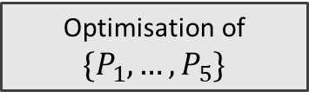



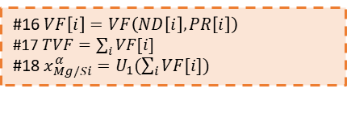

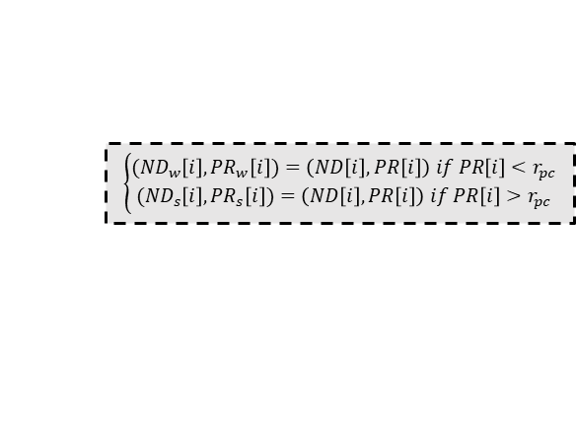

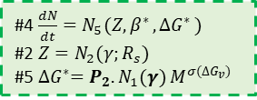


Input composition and process parameters
KWN model
CALPHAD
#10 $b_{5}=G_{1}(x_{Mg/Si}^{α})$
#8 $vel_{growth}\left[j\right]=b_{5}.b_{6}\left[j\right].b_{7}\left[j\right],$
$$∀j∈\{0,…,i\}$$
#11 $b_{6}\left[j\right]=P_{4}\frac{G_{2}\left(γ\right)}{PR\left[j\right]},$
$$∀ j∈\{0,…,i\}$$
#1 $R_{s}=P_{1}.N_{3}\left(γ\right)$
#3 $β^{∗}=N_{4}(R_{s},x_{Mg/Si}^{α})$
#12 $b_{7}\left[j\right]=\frac{1}{Rs}−\frac{1}{PR\left[j\right]}$
$$,∀j∈\{0,…,i\}$$
#4 $\frac{dN}{dt}=N_{5}(Z{,β}^{∗}{,∆G}^{∗})$
#2 $Z=N_{2}(γ;R_{s})$
#5 ${∆G}^{∗}=P_{2}.N_{1}(γ)$ $M^{σ(∆G_{v})}$
#9 $vel_{coarsening}\left[j\right]=P_{5}.b_{10}.b_{6}[j].coars/PR[j]$ $,$
$$∀j∈\{0,…,i\}$$
#13 $b_{10}=1/\sum_{Si, Mg}{{xp}_{Si,Mg}{d2Gx}_{Si,Mg}}$
#14 ${d2Gx}_{Si/Mg}=\frac{RT}{D_{Mg/Si}}$
Optimisation of ${\{P}_{1},…, P_{5}\}$
#6 $ND\left[i\right]=dt\frac{dN}{dt}$
#7 $PR\left[i\right]=R_{s}+P_{3.}N_{6}(γ)$
#16 $VF\left[i\right]=VF\left(ND\left[i\right], PR\left[i\right]\right)$
#17 $TVF=\sum_{i}{VF[i]}$
#18 $x_{Mg/Si}^{α}=U_{1}(\sum_{i}{VF[i]})$
#15 $PR\left[j\right]+=(vel_coarsening [j]+vel_growth [j])∗dt,$
$$∀j∈\{0,…,i\}$$
$$\left\{\begin{aligned}{(ND}_{w}\left[i\right],{PR}_{w}\left[i\right])=\left(ND\left[i\right],PR\left[i\right]\right) if PR\left[i\right]<r_{pc} \\ {(ND}_{s}\left[i\right],{PR}_{s}\left[i\right])=\left(ND\left[i\right],PR\left[i\right]\right) if PR\left[i\right]>r_{pc}\end{aligned}\right.$$
#19 ${τ_{c}}_{weak}=S_{2}({ND\left[i\right]}_{w},{PR[i]}_{w})$
#20 ${τ_{c}}_{strong}=S_{3}({ND\left[i\right]}_{w},{PR[i]}_{w})$
Nucleation
Growth
#21 $σ_{ppt}=S_{1}({τ_{c}}_{weak},{τ_{c}}_{strong})$
Strength
Update
Output $YS, TND, MPR, TVF$

